Slide 1




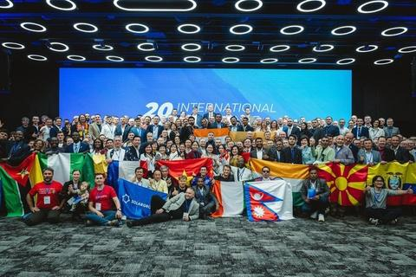
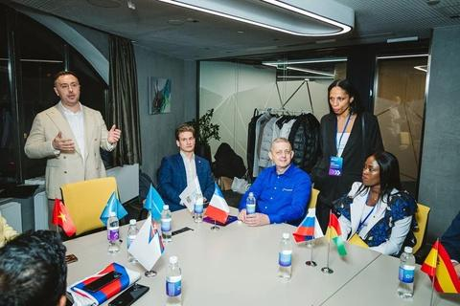
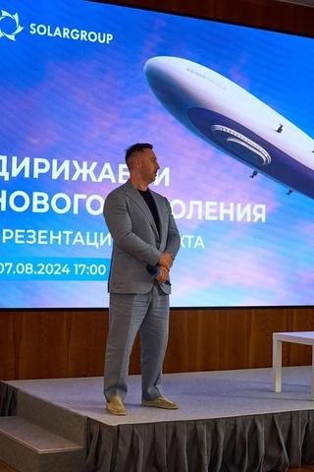
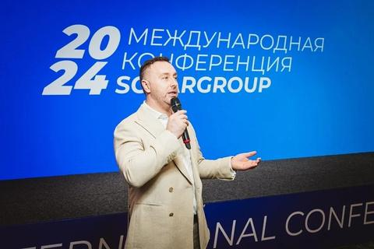
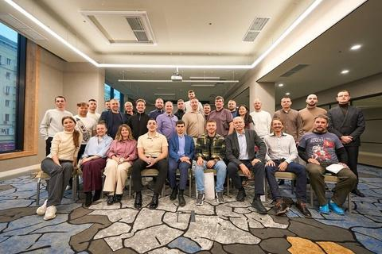
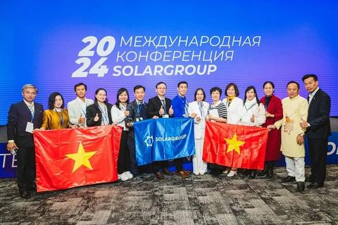
WELCOME TO THE SOLARGROUP TEAM!
SOLARGROUP unites investors from 194 countries and creates new technological opportunities
SOLARGROUP is an innovative service for micro-investors.
This video was created using AI

Slide 2








RELIABILITY AND TRANSPARENCY
International standards
Our work complies with international legal norms, including the UN Charter of Economic Rights, and is confirmed by an international brokerage license
Agility and long-term development
The company is effectively adapting to changes in the international financial market and building a strategy aimed at long-term growth
SOLARGROUP operates strictly within the legal framework, eliminating any risks associated with non-transparency
We guarantee reliability, legal integrity and protection of each participant's interests
Legal support
Each participant can get legal support and guidance on any issues related to the company's business operations and projects
SOLARGROUP is an innovative service for micro-investors.
This video was created using AI

Slide 3
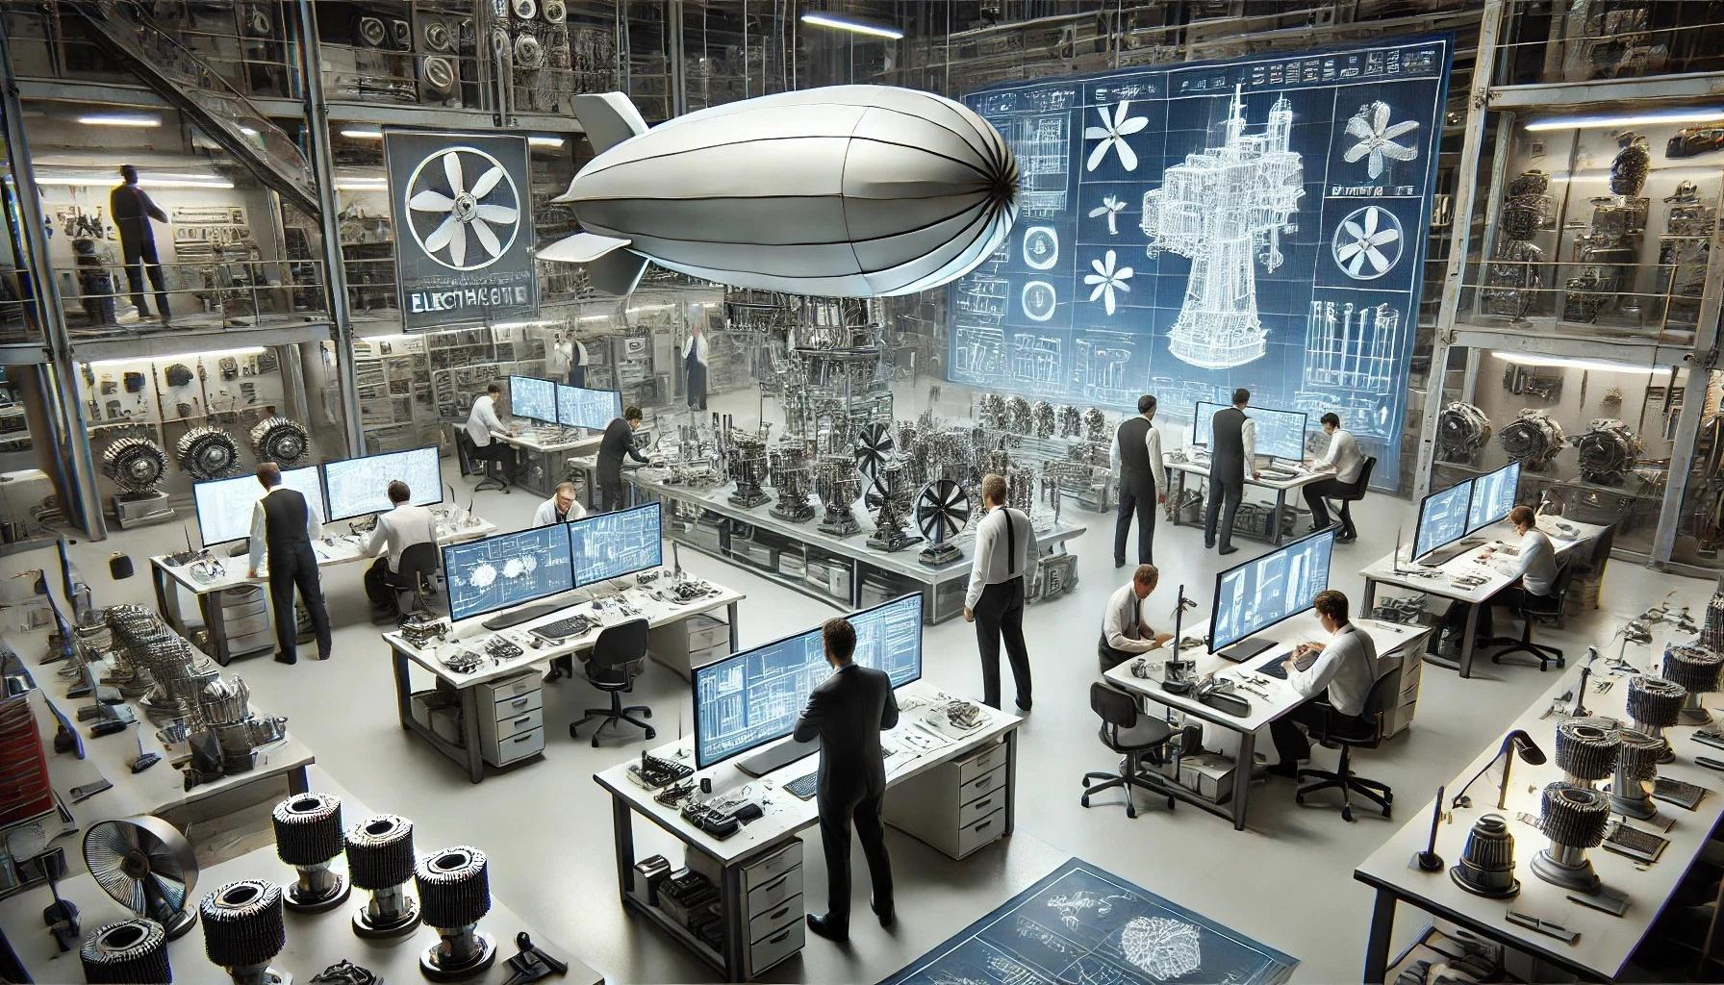
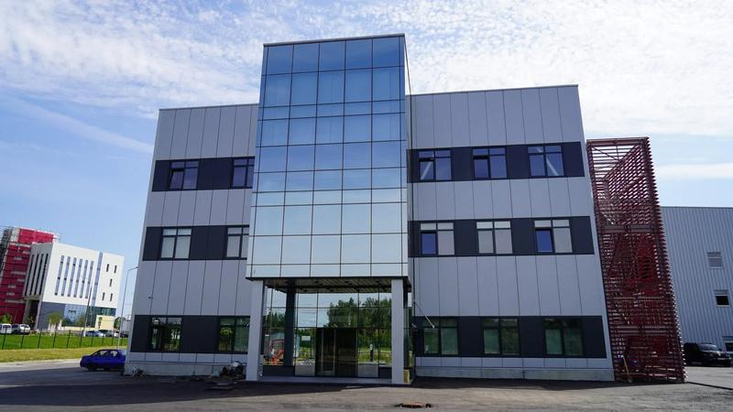
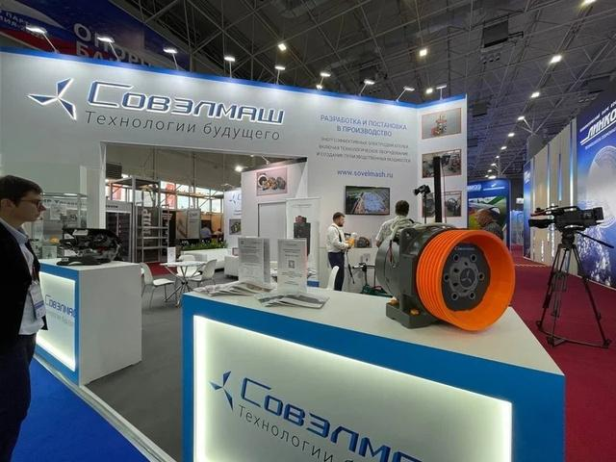
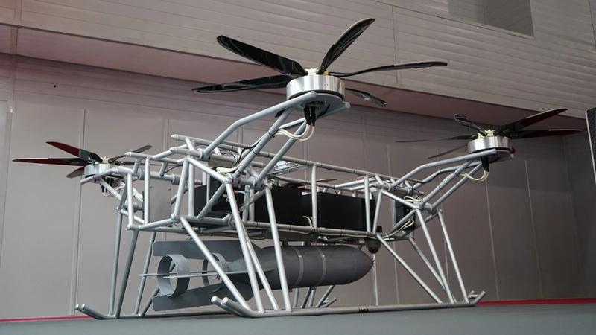



PROVEN TECHNOLOGIES ONLY
Funding for cutting-edge developments
We support technology projects with high growth potential and the potential to become market leaders
RIGOROUS SELECTION OF PROJECTS
PRACTICAL APPLICATION
BEST
INNOVATIONS
Developments that rely on patented technologies and validated research are given preference
The selection of projects takes into account successful experience in implementing technologies and successful business cases confirming their viability
SOLARGROUP invests in developments that have the potential to become global trends and influence the development of the industry
SOLARGROUP is an innovative service for micro-investors.
This video was created using AI

Slide 4


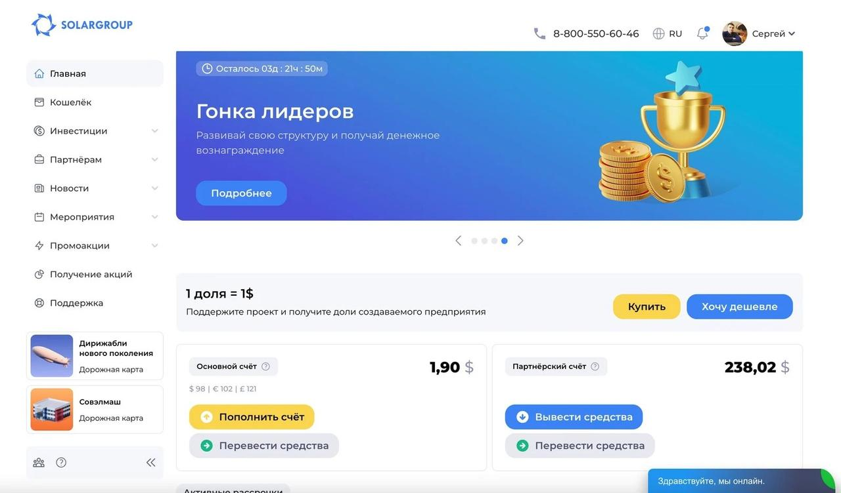

INVESTMENTS ARE ACCESSIBLE TO EVERYONE
Accessibility for everyone
Crowdinvesting makes it possible for anyone from any country to support innovative projects and become a co-owner of a business
SOLARGROUP is an innovative service for micro-investors.
This video was created using AI

Slide 5
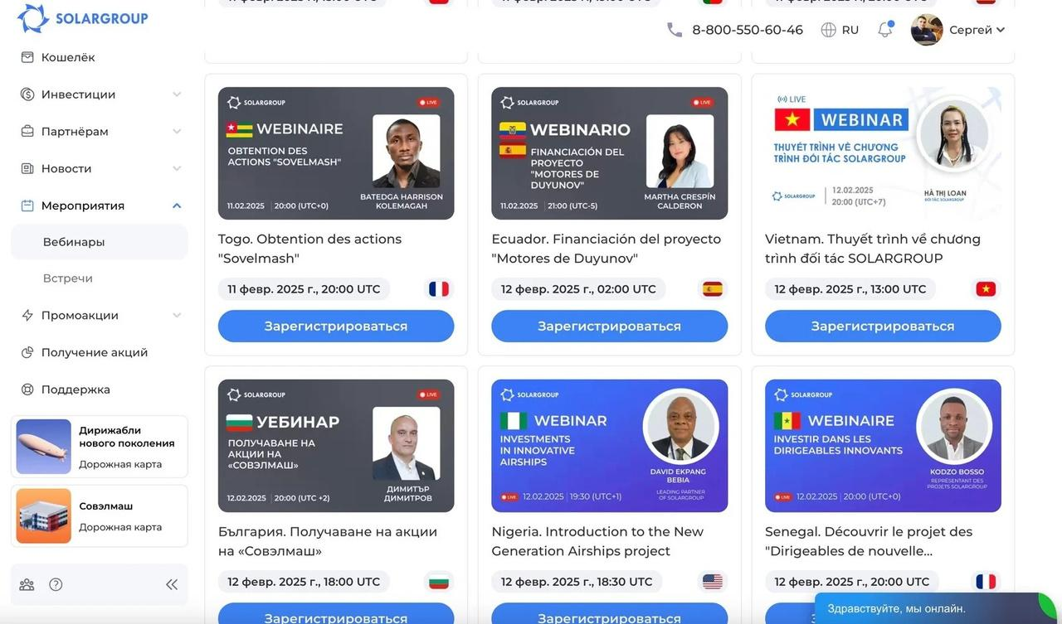
INVESTMENTS ARE ACCESSIBLE TO EVERYONE
State-of-the-art IT solutions
Intuitive interface and user-friendly back office for managing investments
SOLARGROUP is an innovative service for micro-investors.
This video was created using AI

Slide 6
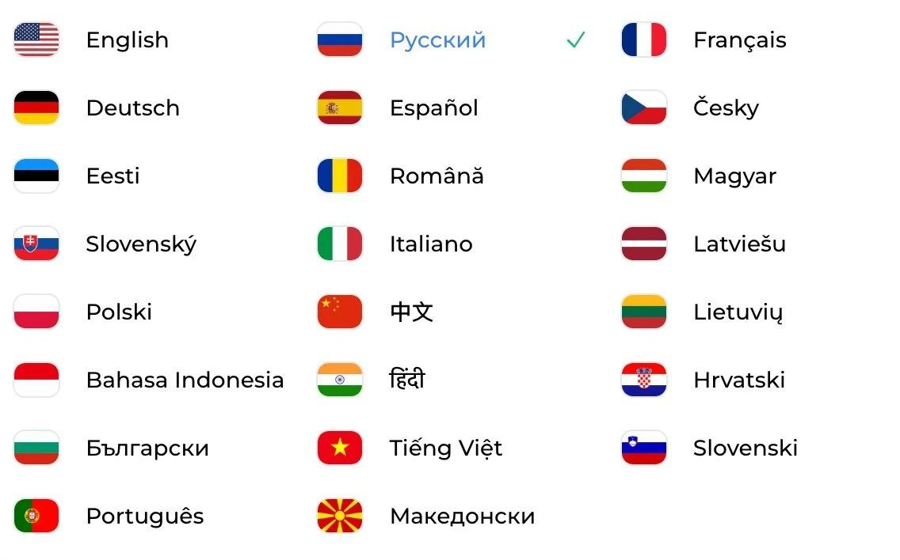
INVESTMENTS ARE ACCESSIBLE TO EVERYONE
Global presence
The platform supports 23 languages, facilitating the participation of investors from all over the world
SOLARGROUP is an innovative service for micro-investors.
This video was created using AI

Slide 7
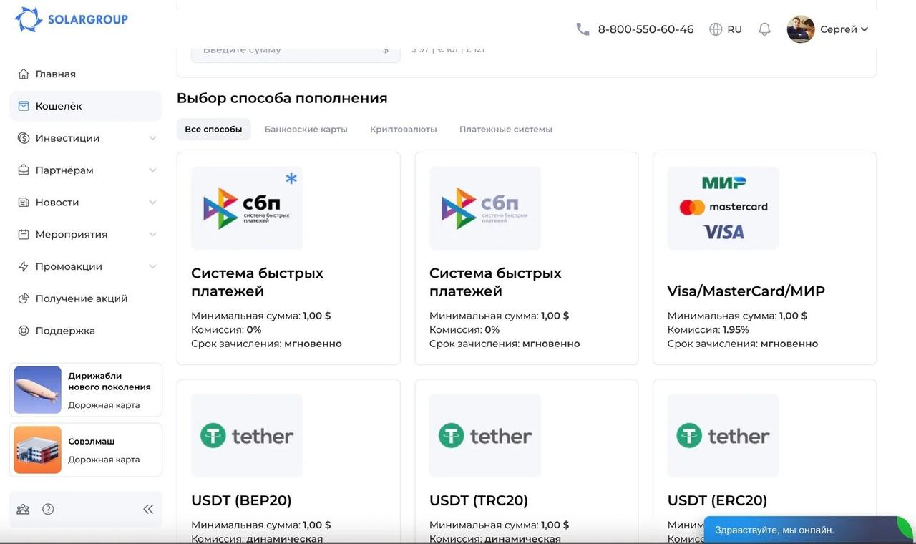
INVESTMENTS ARE ACCESSIBLE TO EVERYONE
Diversity of payment methods
More than 20 payment methods are available, including SWIFT, bank cards, e-wallets and cryptocurrencies
SOLARGROUP is an innovative service for micro-investors.
This video was created using AI

Slide 8
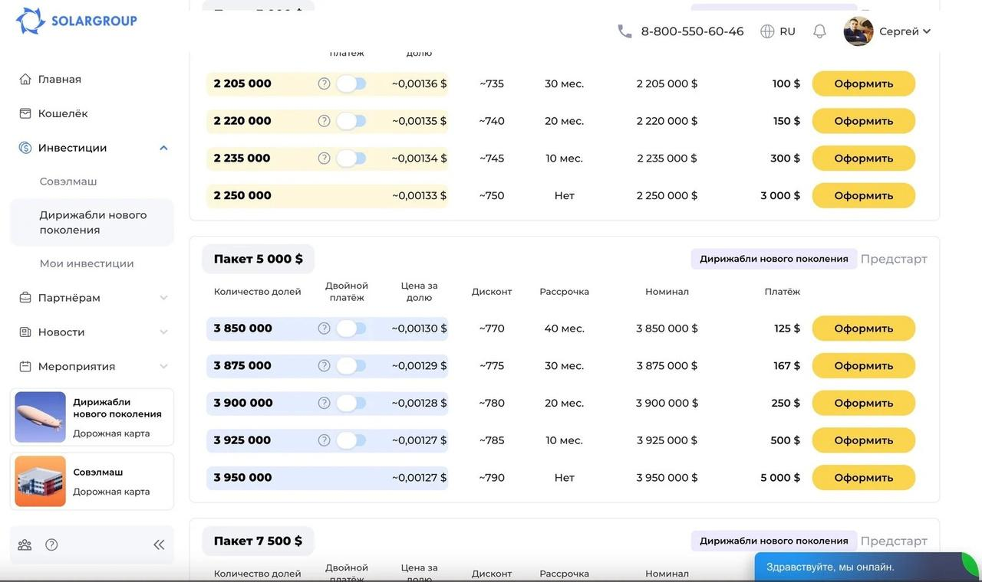
INVESTMENTS ARE ACCESSIBLE TO EVERYONE
Flexible installment plans
Opportunity to fix the price of investment shares in the project and repay them in installments
SOLARGROUP is an innovative service for micro-investors.
This video was created using AI

Slide 9
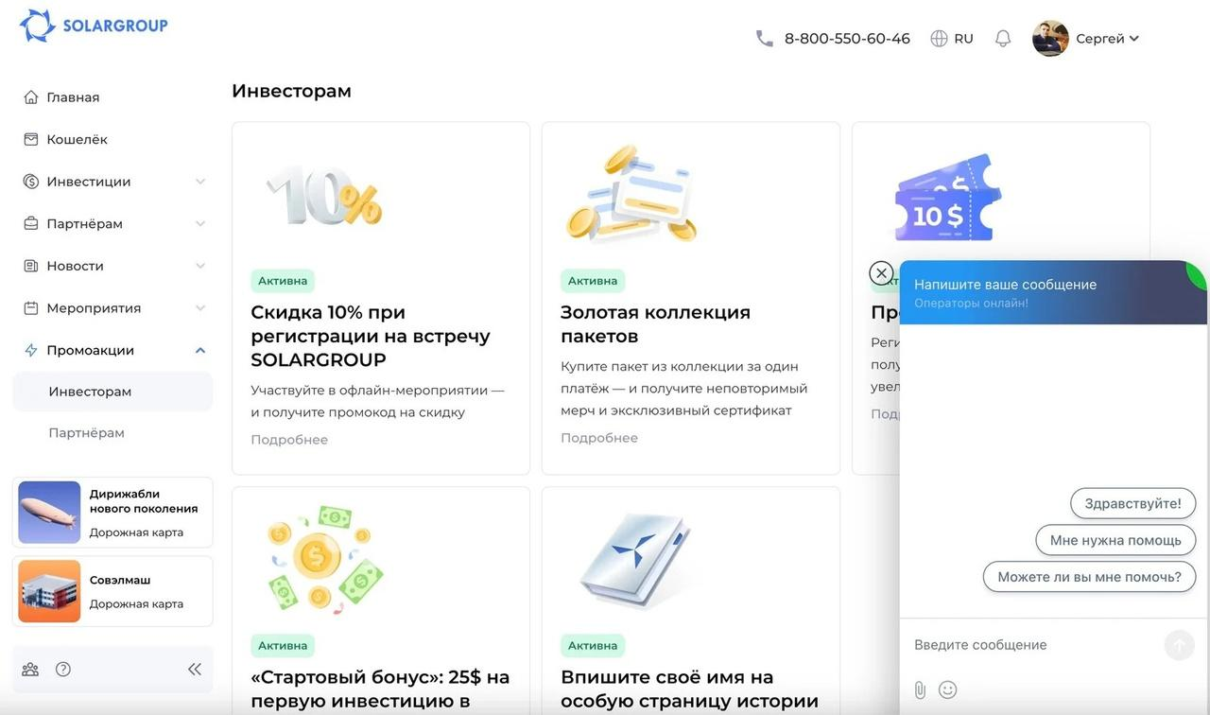
INVESTMENTS ARE ACCESSIBLE TO EVERYONE
24/7 support
24/7 support service offers assistance to investors on all matters
SOLARGROUP is an innovative service for micro-investors.
This video was created using AI

Slide 10




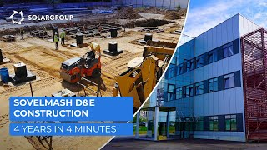
SOLARGROUP FUNDS INNOVATION
SUCCESS OF THE SOVELMASH PROJECT
A major engineering center for the development of energy-efficient electric motors has been established
SOLARGROUP is an innovative service for micro-investors.
This video was created using AI

Slide 11



SOLARGROUP PARTNER PROGRAM
System of profitable cooperation and transparent marketing
OUR RESULTS:
NUMBER OF COUNTRIES WITH PARTNERS PROMOTING OUR PROJECTS
AMOUNT PAID OUT TO PARTNERS
194
$ 35 MILLION
MATERIALS TO PROMOTE OUR PROJECTS IN
NUMBER OF PARTNERS PROMOTING OUR PROJECTS
21 600
23 LANGUAGES
SOLARGROUP is an innovative service for micro-investors.
This video was created using AI

Slide 12



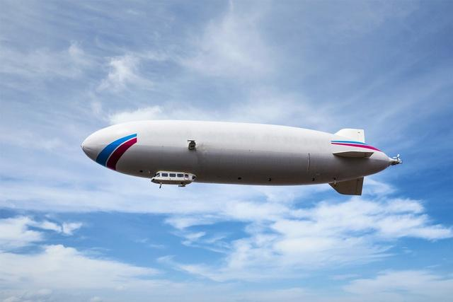



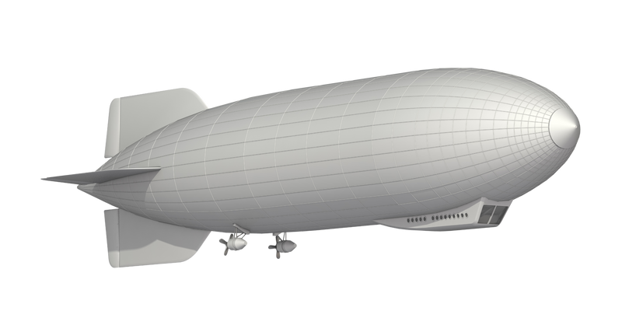
SEVEN YEARS OF STABLE GROWTH AND NEW OPPORTUNITIES
From the success of Sovelmash to a revolution in air transport
SUSTAINABILITY
FUNDING
SOLARGROUP currently supports two technology projects with high potential to enter the global market
SOLARGROUP has been successfully developing for more than seven years, demonstrating reliability even in challenging economic conditions
TEAM
Engineers, researchers, IT specialists and leading experts ensure a high level of project implementation
PROJECT LAUNCH!
In August 2024, the pre-launch stage of the New Generation Airships project was announced
SOLARGROUP is an innovative service for micro-investors.
This video was created using AI

Slide 13



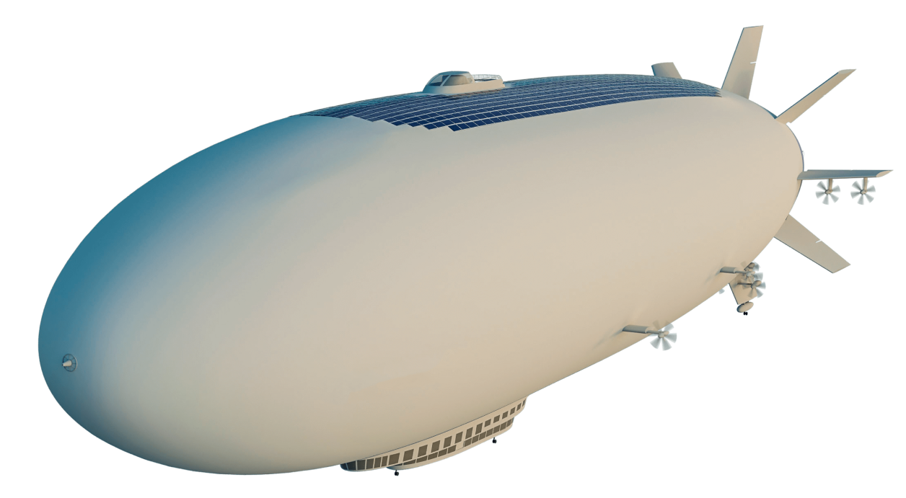


NEW PROJECT NAMED NEW GENERATION AIRSHIPS
SOLARGROUP is an innovative service for micro-investors.
This video was created using AI

Slide 14
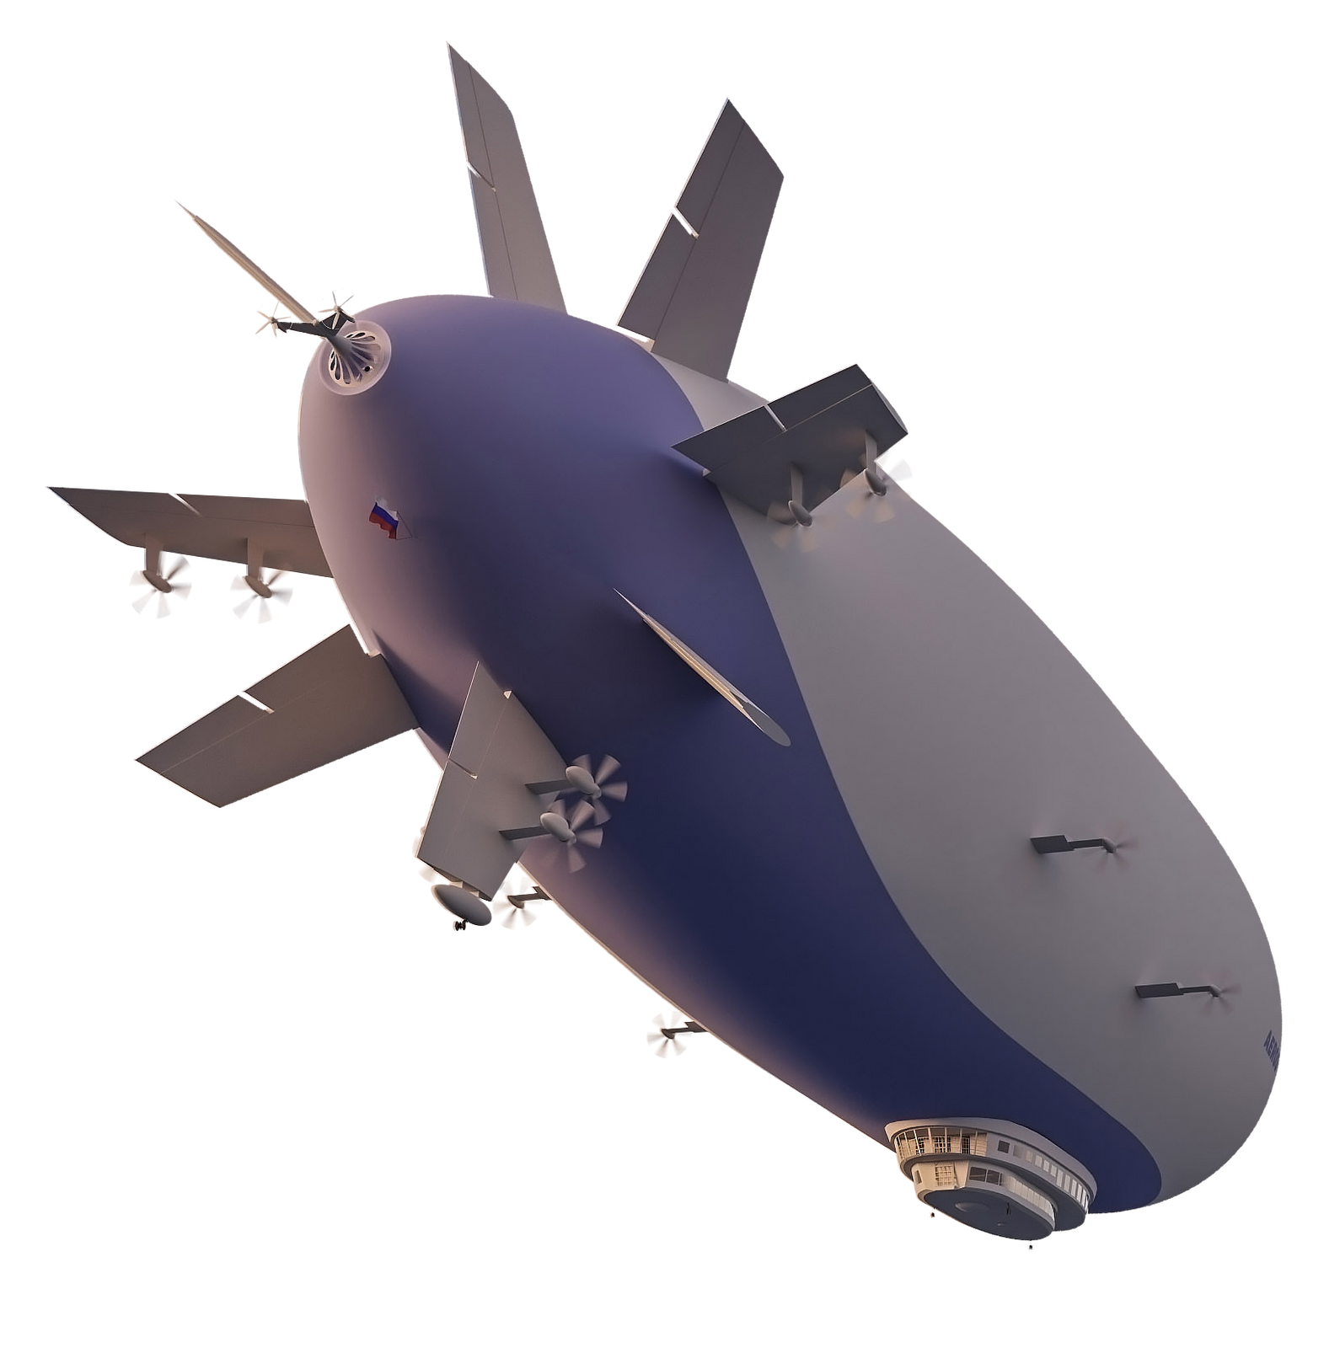

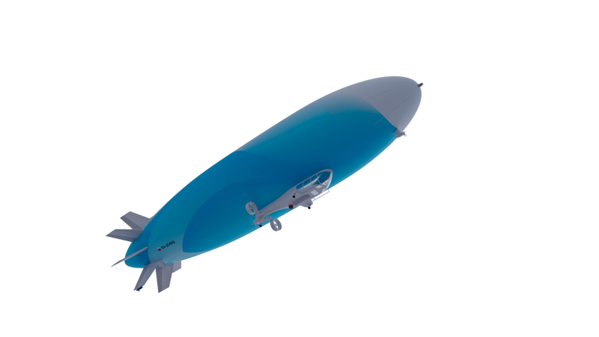
UP-AND-COMING INDUSTRY
The first flights will be possible in 3 to 5 years
Airship construction will address pressing industrial, environmental, economic, logistical and household issues and will considerably change the usual landscape of life
The development of new airships is already being carried out in Russia, USA, UK, Germany, Canada, China and Japan
Independent estimates put the value of the global airship market at $ 50,000,000,000 in the next 20 years
In the next 25 to 30 years, several thousand airships of different sizes and carrying capacities may be sought after on the market
SOLARGROUP is an innovative service for micro-investors.
This video was created using AI

Slide 15


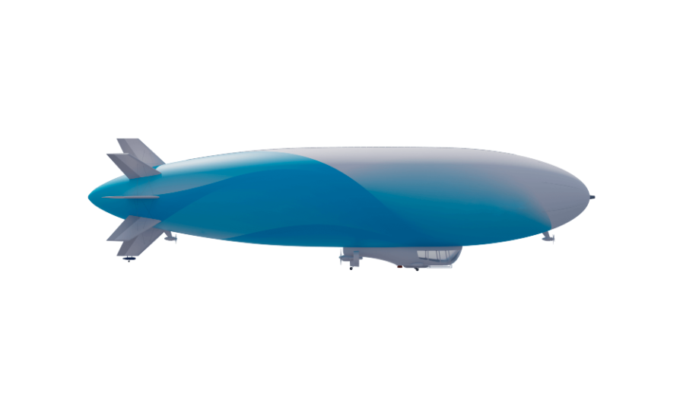



GLOBAL TREND
The startup of Sergey Brin, founder of Google LTA, is gearing up to demonstrate its first airship Pathfinder 1
Despite the rapid revival of interest in airships around the world, the field is still untapped and the market is far from being saturated
Israeli company Atlas LTA, headed by Gennadiy Verba, aims to launch electric airships
3D visualization of AERONOVA's multi-purpose airship with a hybrid power unit
China's Huajiao Airship Corporation has produced a new two-seat airship HJ-2000
ATG Group of Companies, Worldwide Aeros and others are designing airships with large carrying capacity
We have everything we need to become a market leader
SOLARGROUP is an innovative service for micro-investors.
This video was created using AI

Slide 16
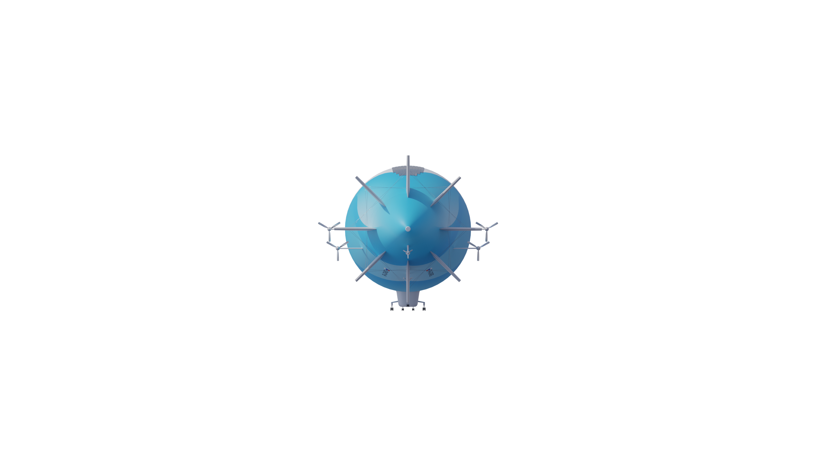






HOW MUCH PROFIT DO AIRSHIPS GENERATE?
WE ARE BUILDING A HIGHLY PROFITABLE BUSINESS FOR ALL ITS PARTICIPANTS
For example:
Our innovative technologies and developments will make it possible to design and produce more state-of-the-art airships, which will be sought after not only in tourism, but also in other fields
Zeppelin NT is engaged in tourism only, organizing short tours from 30 minutes to 2 hours and charging from € 200 to € 890 per ticket. Two tourist airships earn € 150,000,000 per year
Project implementation plan:
Current stage
Expectations in 3 to 5 years
$ 100,000,000 in investments
company's capitalization: from $ 1,000,000,000
SOLARGROUP is an innovative service for micro-investors.
This video was created using AI

Slide 17



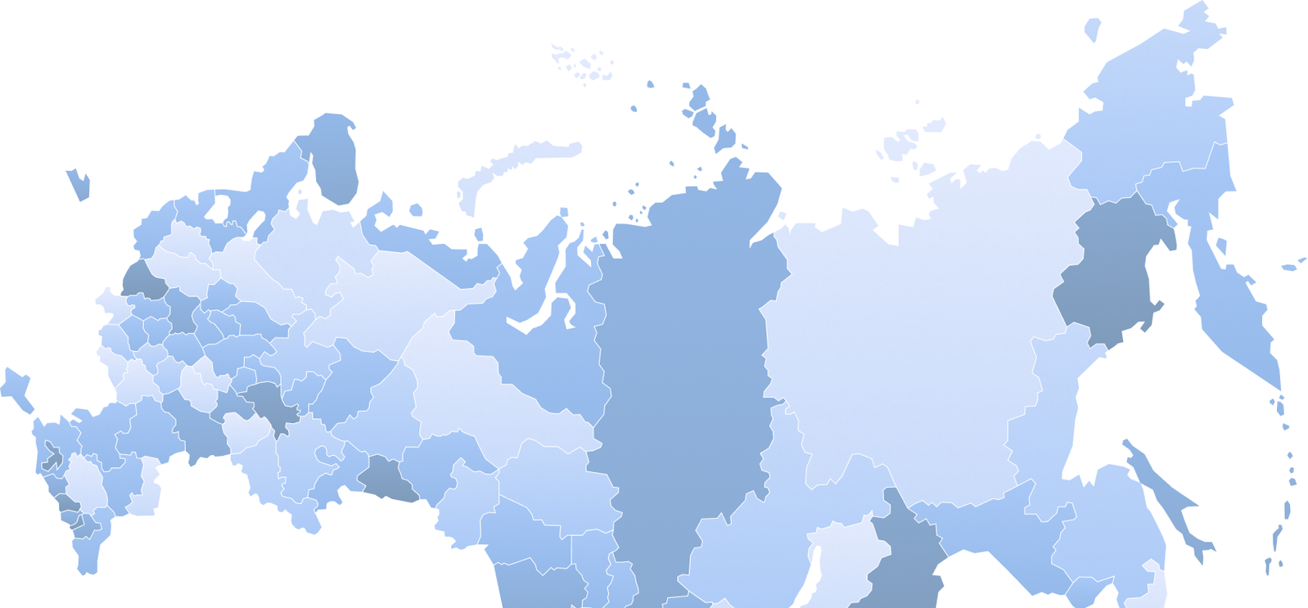

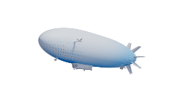
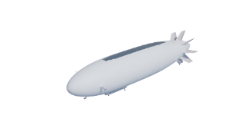

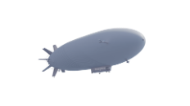


WE ARE TACKLING THE MOST RELEVANT TASKS
Space: launch vehicle transportation, rescue operations
Tourism: round-the-world cruises, flights to the North Pole in airships with comfortable cabins, concert halls, restaurants and recreation areas
Special tasks: rescue operations, monitoring of urban and natural areas, medicine
Passenger transportation: comfortable and safe air travel for people
Cargo transportation of oversized and heavy cargoes anywhere in the world, loading and unloading from the air
SOLARGROUP is an innovative service for micro-investors.
This video was created using AI

Slide 18
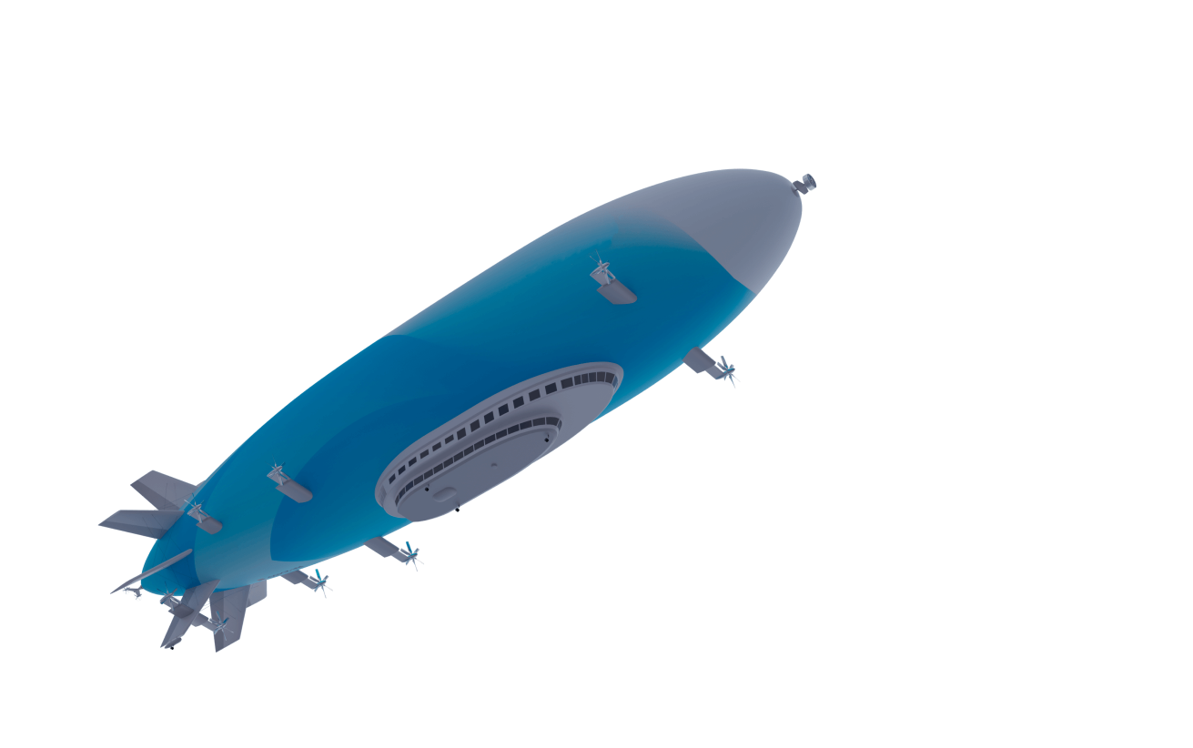
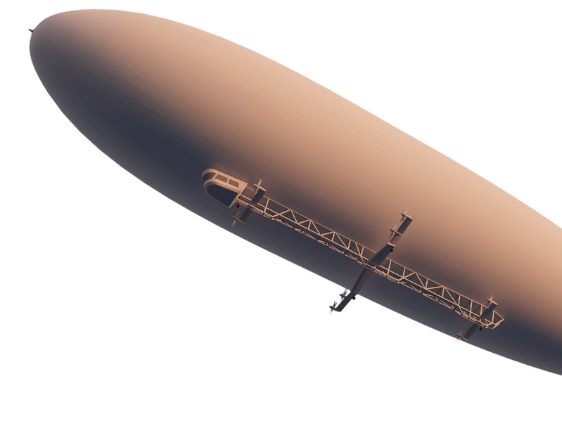




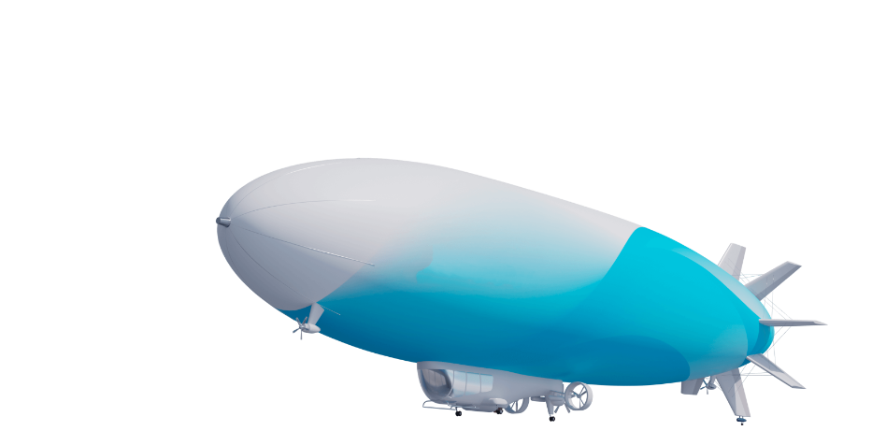

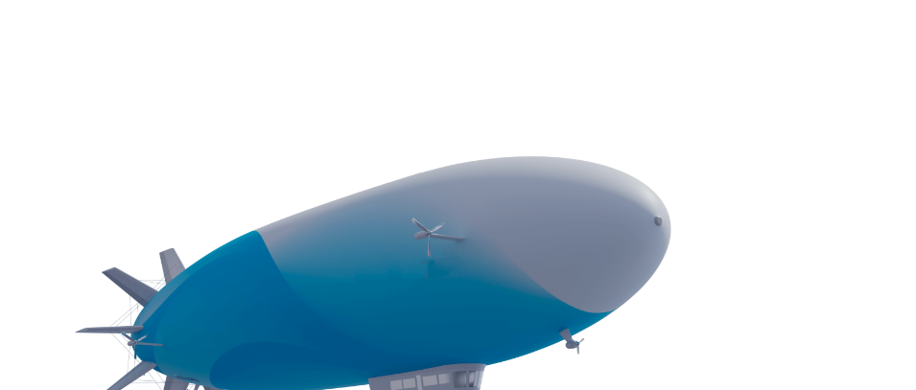
OUR DEVELOPMENTS
The most promising types of airships, some of which will be manufactured under the project
Unmanned stratospheric airship
сarrying capacity: up to 3 tons
non-stop flight range: 2,500 kilometers
relaying of communication signals, area monitoring, cartographic surveying
Carrying capacity: up to 40 tons
non-stop flight range: 9,000 kilometers
transportation of cargo, special-purpose equipment, ocean rescue, intercontinental tourism, flights to the North Pole
Carrying capacity: up to 2 tons
non-stop flight range: 1,000 kilometers
cargo transportation, tourism, advertising, special tasks
Carrying capacity: up to 10 tons
non-stop flight range: 3,000 kilometers
cargo transportation, tourism, area monitoring, fire fighting, relaying of communication signals
SOLARGROUP is an innovative service for micro-investors.
This video was created using AI

Slide 19
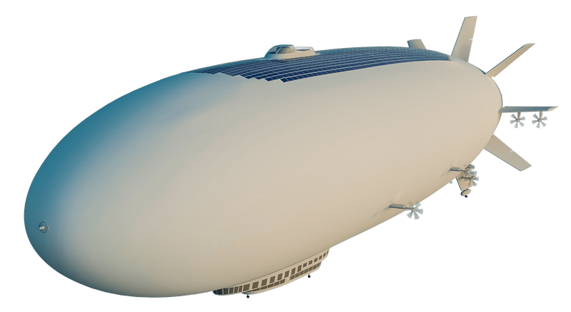






CUSTOMERS
who are ready to be the first to buy and use new generation airships
Rosleskhoz (Federal Agency for Forestry)
Roscosmos (State Corporation for Space Activities)
RosGeo (Russian Geological Holding)
NAMI (Central Scientific Research Automobile and Automotive Engines Institute) Federal State Unitary Enterprise
SOLARGROUP is an innovative service for micro-investors.
This video was created using AI

Slide 20








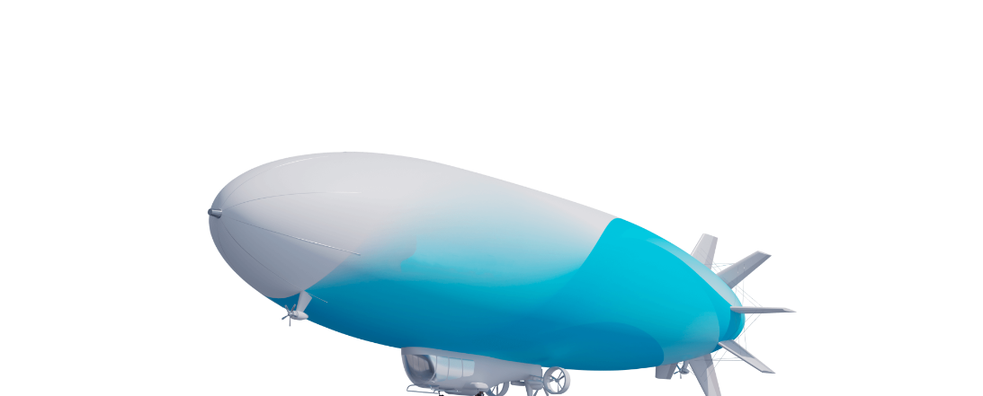

WHY WILL OUR AIRSHIPS BE SOUGHT AFTER?
We intend not to compete with other modes of transportation, but rather to establish a new and efficient industry
LOWER COSTS
SAFER AND MORE ENVIRONMENTALLY FRIENDLY
Lower carrier costs
by 250% than those for airplanes
by 1,000% than those for helicopters
Higher carrying capacity
by 70% than that of airplanes
by 1,000 % than that of helicopters
Higher speed
than that of land and water vehicles
No need for
airfields for takeoff and landing
No fuel required at takeoff
Less impact
on the environment
Comfortable transportation
with low noise and vibration levels
Safe lifting gas
SOLARGROUP is an innovative service for micro-investors.
This video was created using AI

Slide 21











UNIQUE TECHNOLOGIES
Provide conditions for year-round long-duration non-stop flights in all weathers
Use high-efficiency diesel engines, combinations of electric motors and solar panels
15 patents that are considered breakthroughs in the field of airship construction and operation
We can produce the hull faster and at a lower price than others
Ensure mechanized mooring methods with only one or no operator, as well as water landing options
SOLARGROUP is an innovative service for micro-investors.
This video was created using AI

Slide 22
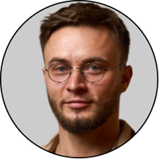
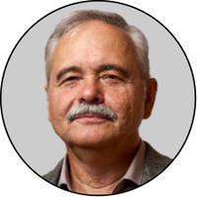
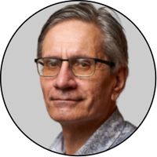
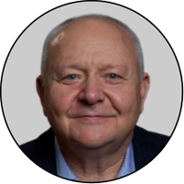

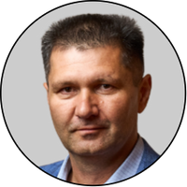
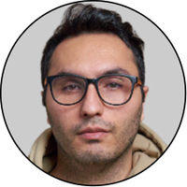
SPECIALISTS OF THE HIGHEST CALIBER
Fyodor Konstantinov
Vadim Zubkevich
Dmitriy Khmel
Boris Ivchenko
Chief Technology Officer at AERONOVA
Chief Designer at AERONOVA
Chief Scientific Officer at AERONOVA
Design Office Director at AERONOVA
Ruslan Arslanov
Milad Ranaei
Production Manager at AERONOVA
Leading ACS (Automated Control System) and AI specialist at AERONOVA
SOLARGROUP is an innovative service for micro-investors.
This video was created using AI

Slide 23



















ADVANCED RESEARCH AND DESIGN ENTERPRISES IN RUSSIA
Zhukovsky Institute National Research Centre
Central Scientific Research Automobile and Automotive Engines Institute
development of airborne systems and means of air traffic management
main contractor for designing the Flying Yacht airship
Dolgoprudny Design Bureau of Automatics
Moscow Aviation Institute
development of aeronautical fabric and film materials, manufacturing outer shell and gas compartment components, making process tooling
formation of the aerodynamic and dynamic appearance of the airship, nacelle modeling
National Institute of Aviation Technology
New Generation Airships
manufacturing nacelle and keel beam frames from aluminum alloys, making composite nacelle panels
general assembly, certification testing, serial production of airships, commercial operation of prototype models
SOLARGROUP is an innovative service for micro-investors.
This video was created using AI

Slide 24





PROJECT TEAM
The project is implemented by several companies, each with its own area of responsibility
49%
AERONOVA
51%
COLLECTIVE INVESTOR SOLARGROUP
INITIATORS OF THE PROJECT
company implementing the project
SOLARGROUP is an innovative service for micro-investors.
This video was created using AI

Slide 25
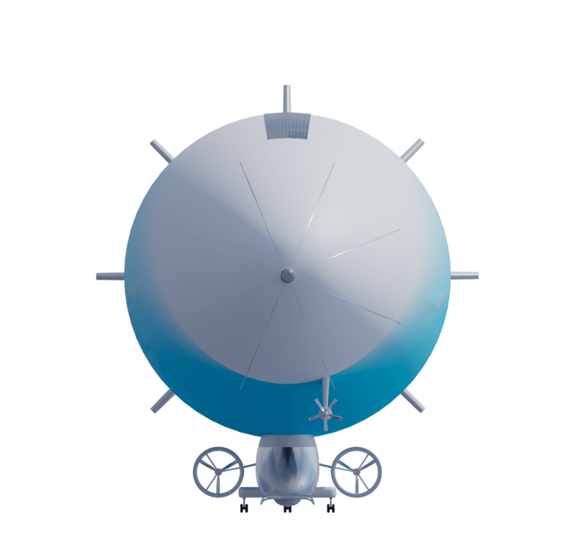











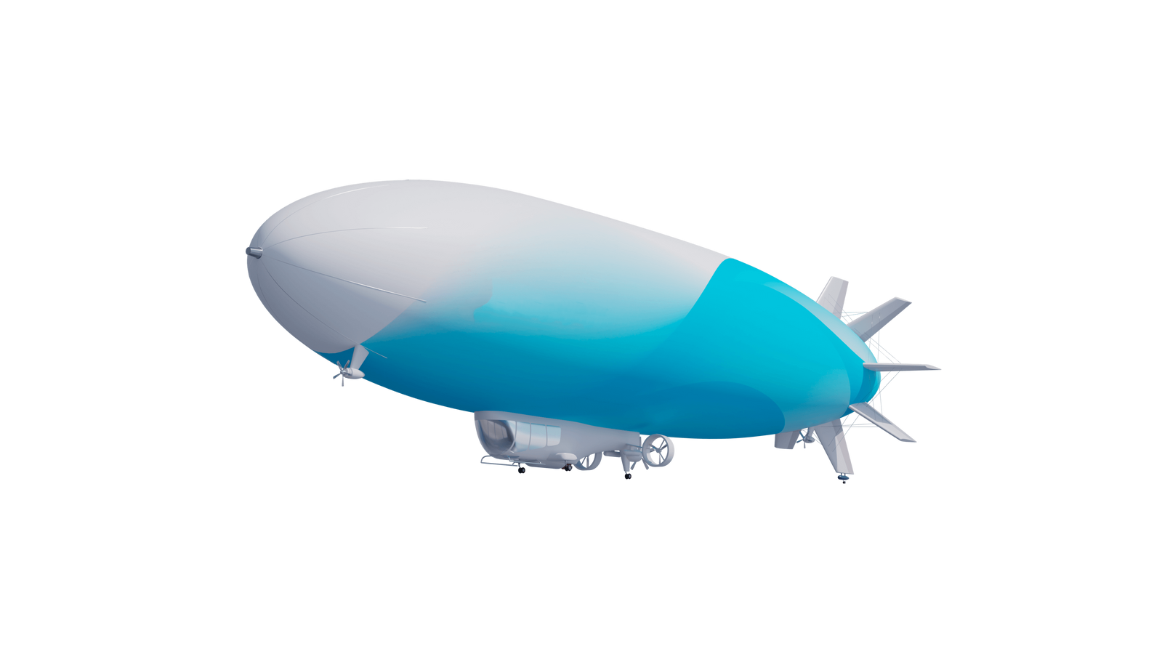




AERONOVA
build an airship facility
A company that is being set up specifically for implementing the project and will:
earn income from implementing the project and distribute it among its co-founders
manufacture, operate and sell airships
design airships
You are now buying investment shares in SOLARGROUP. After the funding is completed, they will be exchanged for the company's shares in AERONOVA and you will be able to earn dividends from the company's profits or sell your assets
SOLARGROUP is an innovative service for micro-investors.
This video was created using AI

Slide 26











HOW DO I BECOME AN INVESTOR?
1
Register on the SOLARGROUP platform
Minimum investment: $ 50
24/7 access to the investment platform
Investor rights are protected by an agreement
2
Purchase an investment package of shares in a lump sum or in installments
3
Save and multiply your capital together with us!
Get income in dividends or from selling the company's shares
SOLARGROUP is an innovative service for micro-investors.
This video was created using AI

Slide 27
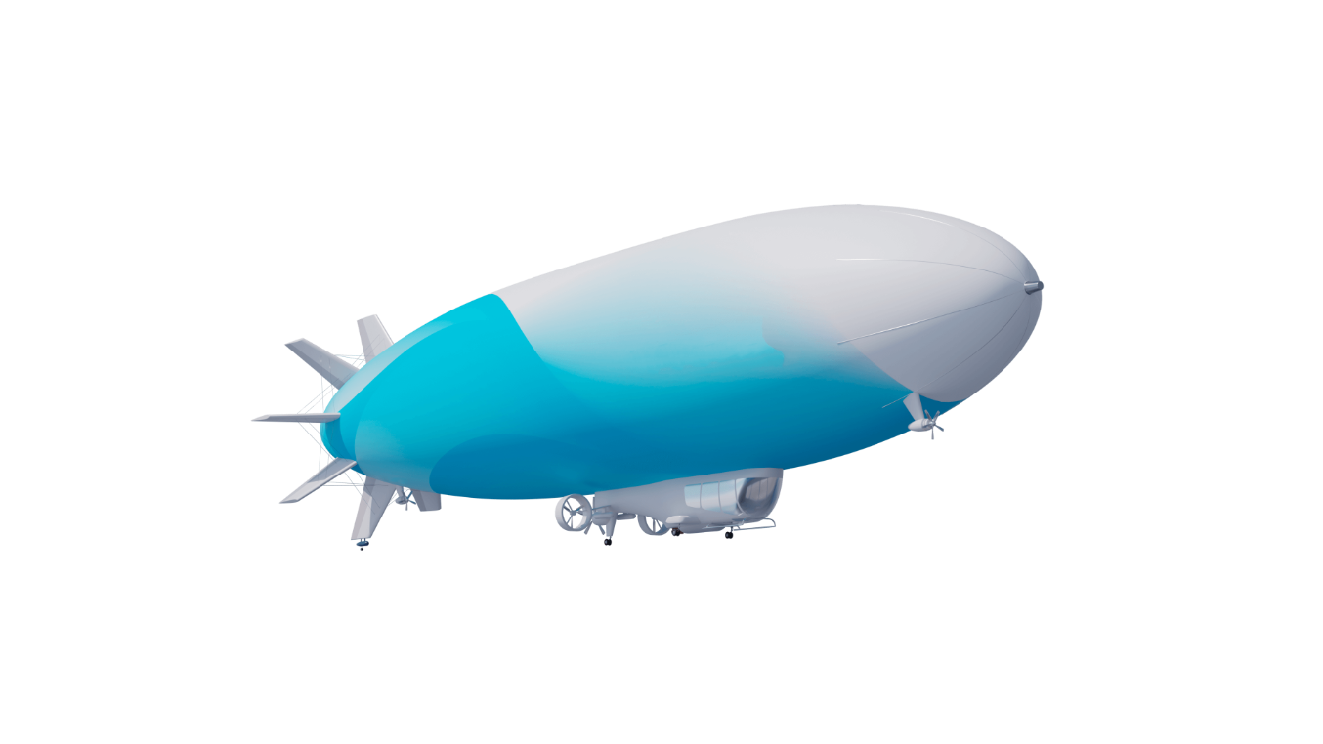

HOW DO I INVEST WITH MAXIMUM PROFIT?
The project funding is divided into stages. The price of investment shares increases with each new stage
Use our installment plan options for easy repayment of a purchased package of shares
1 000
It fixes the current stage discount for the entire repayment period
Hurry up to invest profitably!
500
0
0
1
2
3
4
5
6
7
8
9
10
11
12
13
14
15
16
17
18
19
20
SOLARGROUP is an innovative service for micro-investors.
This video was created using AI

Slide 28




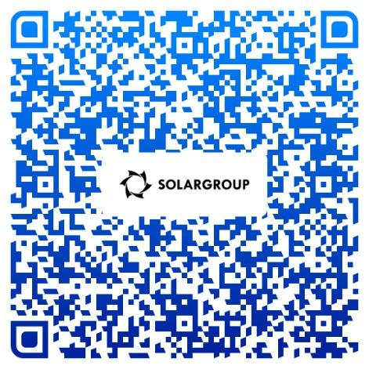




FIND OUT MORE ABOUT THE PROJECT
1
Explore the information provided in the back office
Become a co-owner of an innovative business and earn a profit together with us!
2
Join our weekly webinars
3
Subscribe to our messengers and social media groups
SOLARGROUP is an innovative service for micro-investors.
This video was created using AI

